Slide 1
SKETCHNOTES
LESSON
Here is where your presentation begins

Slide 2
CONTENTS OF THIS TEMPLATE
Here’s what you’ll find in this Slidesgo template:
A slide structure based on a lesson, which you can easily adapt to your needs. For more info on how to edit the template, please visit Slidesgo School or read our FAQs.
An assortment of illustrations that are suitable for use in the presentation can be found in the alternative resources slide.
A thanks slide, which you must keep so that proper credits for our design are given.
A resources slide, where you’ll find links to all the elements used in the template.
Instructions for use.
Final slides with:
The fonts and colors used in the template.
A selection of illustrations. You can also customize and animate them as you wish with the online editor. Visit Storyset to find more.
More infographic resources, whose size and color can be edited.
Sets of customizable icons of the following themes: general, business, avatar, creative process, education, help & support, medical, nature, performing arts, SEO & marketing, and teamwork.
You can delete this slide when you’re done editing the presentation.

Slide 3
TABLE OF CONTENTS
01
02
03
04
Overview
Features
of the Topic
Assignment
About the Topic

Slide 4
INTRODUCTION
Venus has a beautiful name and is the second planet from the Sun. It’s terribly hot—even hotter than Mercury—and its atmosphere is extremely poisonous. It’s the second-brightest natural object in the night sky after the Moon

Slide 5
—Someone Famous
“This is a quote. Words full of wisdom that someone important said and can make the reader get inspired.”

Slide 6
WHAT IS THIS TOPIC ABOUT?
Here you could give a brief description of the topic you want to talk about. For example, if you want to talk about Mercury, you could say that it’s the closest planet to the Sun and the smallest one in our Solar System. It’s only a bit larger than our
Moon, and its name has nothing to do with the liquid metal, since it was named after the Roman messenger god, Mercury

Slide 7
DEFINITION OF CONCEPTS
MERCURY
SATURN
MARS
VENUS
It’s the closest planet to the Sun and the smallest one in our System
It’s the ringed one, composed mostly of hydrogen and helium gas
Despite being red, Mars is actually a cold place. It’s full of iron oxide dust
Venus has a beautiful name
and is the second planet from the Sun

Slide 8
FEATURES OF THE TOPIC
MARS
JUPITER
VENUS
Despite being red, Mars is actually a cold place. It’s full of iron oxide dust, giving the planet its reddish cast
It’s a gas giant and the biggest planet in our Solar System. Jupiter is the fourth-brightest object in the sky
Venus has a beautiful name and is the second planet from the Sun. It’s terribly hot, even hotter than Mercury

Slide 9
7.2M
10K
33,400
Remember that big numbers grab a lot of attention
You can use them to make an impression
In Spain, a comma is used as a decimal separator

Slide 10
PRACTICAL USES OF THIS SUBJECT
MERCURY
VENUS
SATURN
MARS
It’s the closest planet to the Sun
Venus has a beautiful name
Yes, this is the ringed one
Despite being red, Mars is cold

Slide 11
LESSON DEVELOPMENT
01
02
03
04
Mercury is the smallest one
Saturn is the ringed one
Despite being red, Mars is cold
Venus has a beautiful name

Slide 12
Despite being red, Mars is actually a cold place. It’s full of iron oxide dust, which gives the planet its reddish cast
Insert your multimedia content here

Slide 13
DID YOU KNOW...?
MERCURY
SATURN
MARS
Mercury is the closest planet to the Sun
Saturn is the ringed planet and a gas giant
Despite being red, Mars is a cold place

Slide 14
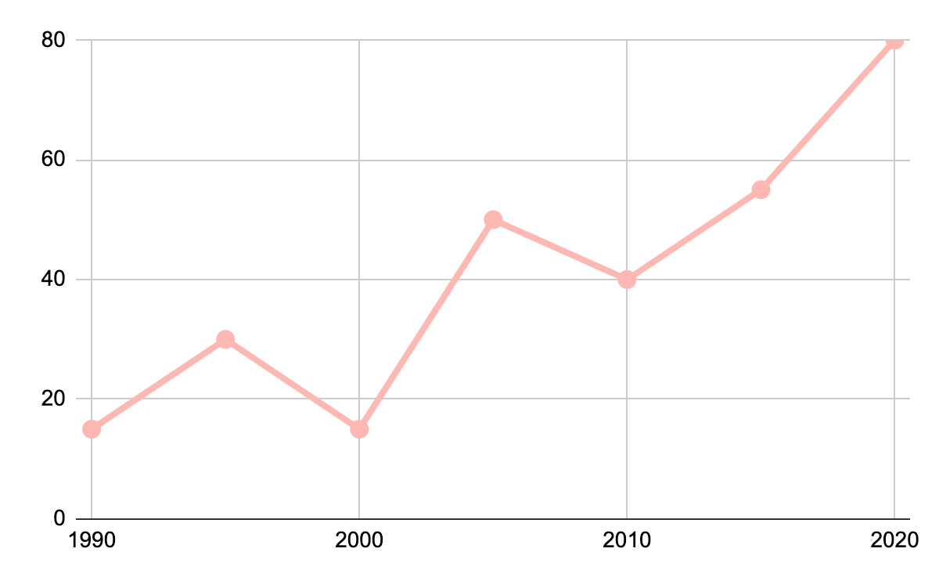
...and did you know this?
Despite being red, Mars is actually a cold place. It’s full of iron oxide dust, which gives the planet its reddish cast
If you want to modify this graph, click on it, follow the link, change the data and replace it here

Slide 15
PROBLEM
SOLUTION
Mercury is the closest planet to the Sun and the smallest one in the
Solar System. It’s only a bit larger than our Moon
Jupiter is a gas giant and the biggest planet in our Solar System. It’s also the fourth-brightest
object in the sky

Slide 16
OVERVIEW DIAGRAM
LESSON 2
LESSON 3
LESSON 4
LESSON 5
PART 1
PART 2
NOVEMBER
DECEMBER
JANUARY
FEBRUARY
MARCH
LESSON 1
Mercury is the closest planet to the Sun
Despite being red, Mars is a cold place
Venus is the second planet from the Sun
Saturn is the ringed planet and a gas giant
Neptune is the farthest planet from the Sun

Slide 17
EXERCISE
?
?
Mercury is the closest planet to the Sun, but does its name have anything to do with the liquid metal?
Contrary to popular belief, no. The truth is that this planet was named after the Roman messenger god, Mercury

Slide 18
ASSIGNMENT
?
Mercury is the closest planet to the Sun, and Neptune is the farthest one. Calculate the distance between these two planets

Slide 19
OTHER CONCEPTS
MERCURY
SATURN
VENUS
MARS
JUPITER
NEPTUNE
It’s the smallest planet in our Solar System and the closest to the Sun
This is the ringed planet, composed mostly of hydrogen and helium
Venus has a beautiful name and is the second planet from the Sun
Despite being red, Mars is actually a cold place. It’s full of iron oxide dust
Jupiter is a gas giant and the biggest planet in our Solar System
Neptune is the farthest planet from the Sun and the fourth-largest

Slide 20
THANKS!
Do you have any questions?
youremail@freepik.com
+91 620 421 838
yourcompany.com
Please keep this slide for attribution.

